Slide 1
KEYLOGGER AND SECURITY
NAME : SISINDRI DEVATHOTI
1

Slide 2

Introduction to Keyloggers and Security
Keyloggers are software programs or hardware devices used to track and record keystrokes on a computer.
They can be used for legitimate purposes such as monitoring employee productivity or parental control.
However, keyloggers can also be used maliciously to steal sensitive information like passwords and credit card details.
2

Slide 3
Types of Keyloggers
Software Keyloggers: Installed on a computer without the user's knowledge, can be detected and removed by antivirus programs.
Hardware Keyloggers: Physical devices inserted between the keyboard and computer, difficult to detect but require physical access.
Wireless Keyloggers: Similar to hardware keyloggers but transmit data wirelessly, also hard to detect.
3

Slide 4

Advantages of Using Keyloggers for Security
Monitoring Employee Activity: Helps employers track productivity and detect any unauthorized activities.
Parental Control: Allows parents to monitor their children's online activities and protect them from potential dangers.
Investigative Purposes: Law enforcement agencies use keyloggers to gather evidence in criminal investigations.
4

Slide 5

Disadvantages of Using Keyloggers for Security
Privacy Concerns: Keyloggers can potentially invade an individual's privacy by capturing sensitive information without consent.
Legal Issues: In some countries, using keyloggers without the target's permission is illegal and can lead to legal consequences.
Vulnerability to Malware: Keyloggers themselves can be targeted by malware, leading to the compromise of the captured data.
5

Slide 6
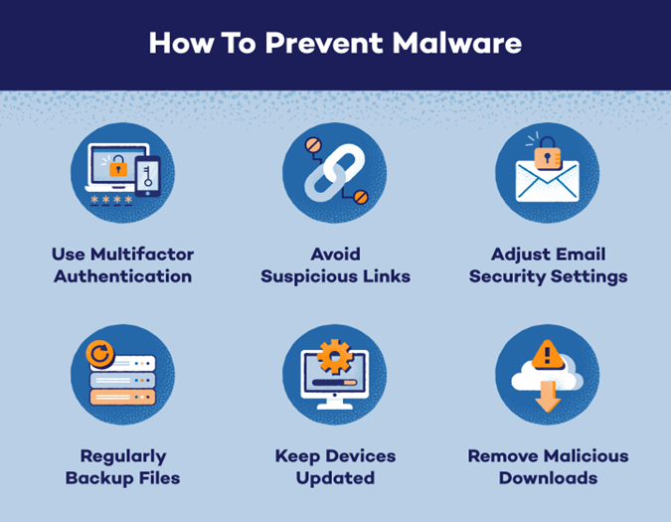
Security Measures Against Keyloggers
Use Antivirus Software: Regularly scan your computer for keyloggers and other malware to prevent unauthorized access.
Enable Firewall Protection: A firewall can block suspicious network activity that may be related to keyloggers.
Secure Password Practices: Use strong, unique passwords and consider using password managers to protect sensitive information.
6

Slide 7
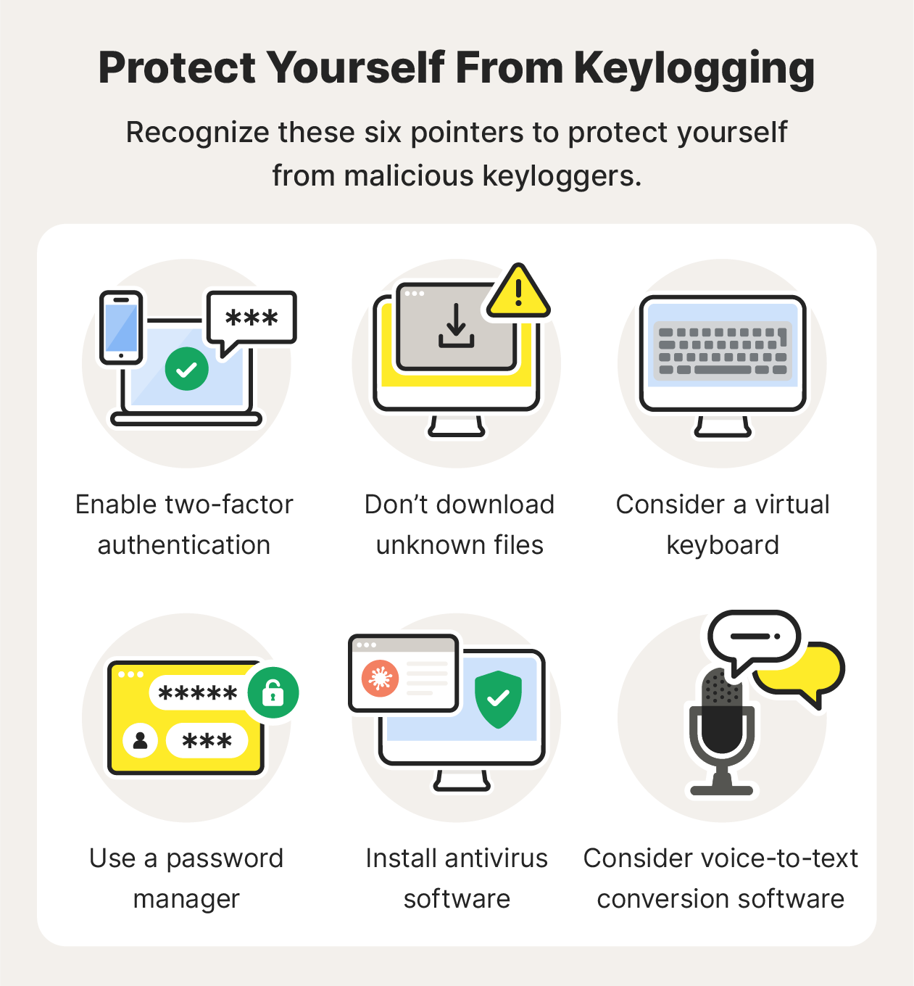
Advantages of Keyloggers for Cybersecurity Professionals
Detection of Insider Threats: Keyloggers can help cybersecurity professionals identify malicious activities from within the organization.
Incident Response: Keyloggers provide valuable data during incident response investigations to understand the scope of a security breach.
User Behavior Analysis: Monitoring keystrokes can help analyze user behavior patterns and detect anomalies that may indicate a security threat.
7

Slide 8

Disadvantages of Keyloggers for Cybersecurity Professionals
Ethical Concerns: Using keyloggers to monitor employees or individuals without their knowledge raises ethical questions about privacy.
False Positives: Keyloggers may generate false positives, leading to unnecessary investigations and potential breaches of privacy.
Data Security Risks: Storing captured keystrokes poses a risk of data exposure if not properly secured, potentially leading to data breaches.
8

Slide 9

WORKING WITH KEYLOGGER
For the working of the keylogger we have a keylogger.py file which containing the payload that is used to monitor the target device.
First we need to execute the keylogger file either we can run it in the idle for python execution or else we can execute the file in the command prompt as seen in the left side of the picture.
The we get a display for whether to start or stop the keylogger as shown in right bottom of the picture.
After we have started we can do whatever we want to do then automatically that is recorded in the form of the characters.
After stopping the keylogger file we can see a file like keylogger.txt which stores the result of the execution.

Slide 10

Best Practices for Using Keyloggers in a Security Context
Obtain Consent: Always obtain consent before deploying keyloggers for monitoring purposes to maintain ethical standards.
Secure Data Storage: Encrypt captured data and implement robust security measures to protect sensitive information from unauthorized access.
Regular Auditing: Conduct regular audits of keylogger usage to ensure compliance with legal regulations and ethical guidelines.
9

Slide 11

Conclusion
Keyloggers can be valuable tools for security and monitoring purposes, but they also pose privacy and ethical concerns.
It is essential to weigh the advantages and disadvantages of using keyloggers and implement them responsibly to maintain a balance between security and privacy.
By following best practices and security measures, keyloggers can be effectively utilized to enhance cybersecurity efforts while respecting individual privacy rights.
Contact : https://github.com/sisindri3108
10

